Slide 1
INTRODUCTION TO MACHINE LEARNING
Recap Week 1
Pablo Cañas
pablocanas97@gmail.com
NORTHIN SUMMER SCHOOL
Barcelona, July 2023

Slide 2
Course structure
Introduction: basic concepts, data preparation, linear regression
Fundamental Machine Learning concepts: Loss functions, optimization, cross-validation, overfitting
Supervised learning: naive bayes, k-NN, random forests, …
Unsupervised learning: clustering, dimensionality reduction.
Introduction to Deep Learning

Slide 3
What is Machine learning?
Machine Learning is the science of getting computers to learn and act like humans do, and improve their learning over time in autonomous fashion, by feeding them data and information in the form of observations and real-world interactions
Machine learning algorithms seek to provide knowledge to computers through data, observations, and interaction with the world. It is then used to make accurate predictions given new observations.
Machine learning is applied statistics!

Slide 4
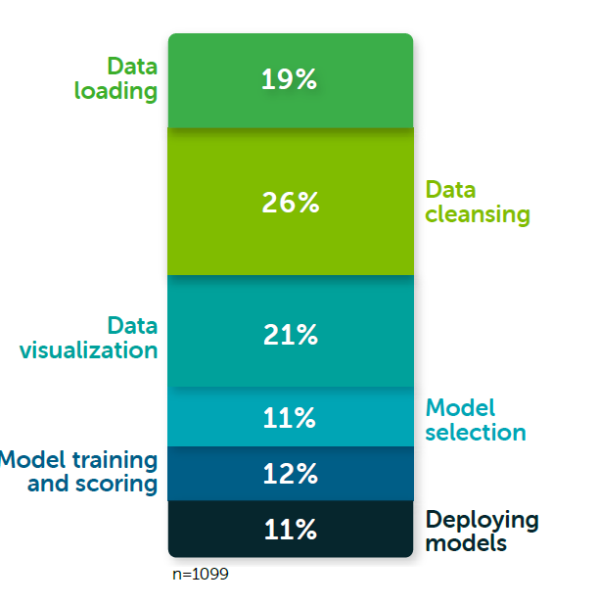

Data preparation
Data is the oil of machine learning
Prepare and analyse the data before applying machine learning!
66% Data preparation
Source: Anaconda
Source: Memegenerator

Slide 5
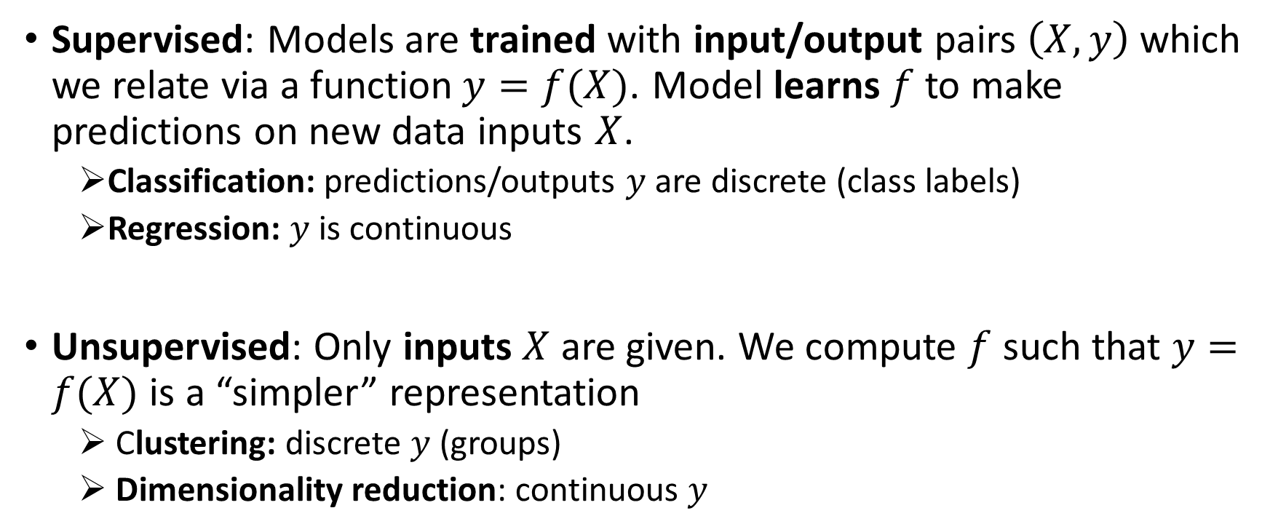
Machine learning algorithms

Slide 6
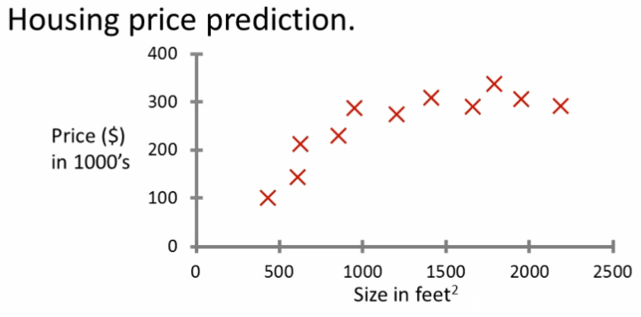
Supervised Learning: Regression
Predict continuous valued output. Ex: Housing price prediction.
Linear regression model, predict price
Source: Coursera

Slide 7
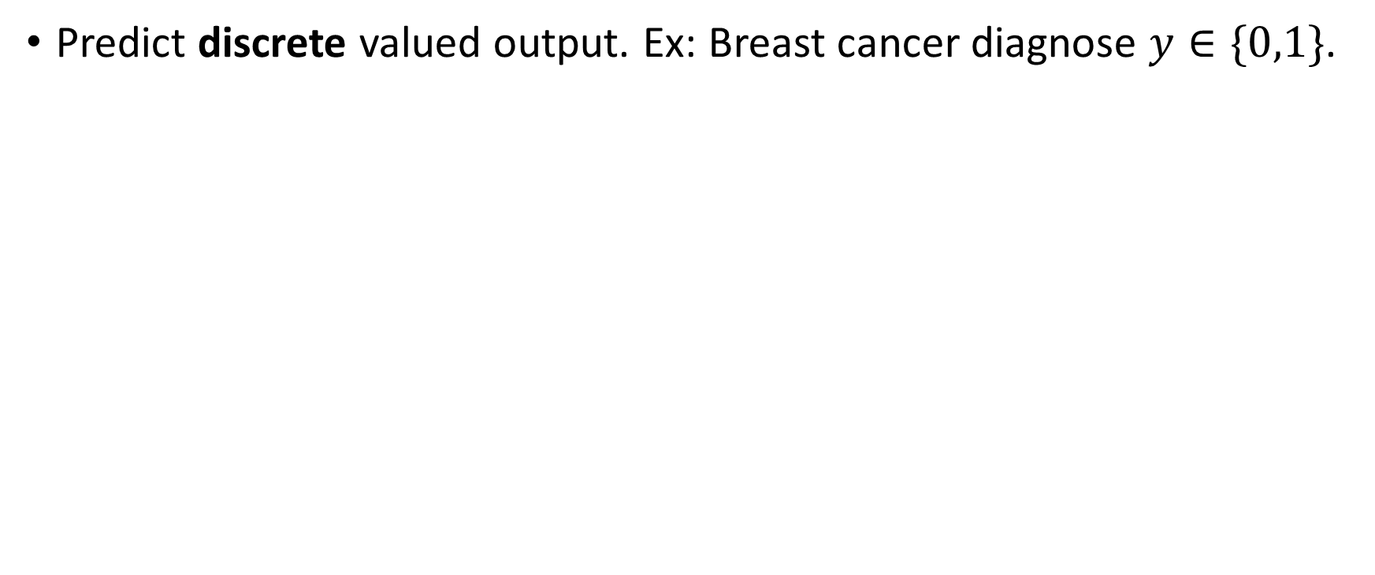
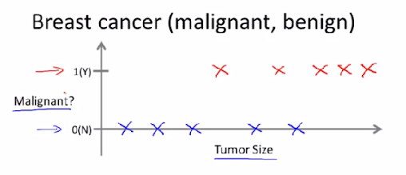
Supervised Learning: Classification
Logistic regression model, predict class probabilities

Slide 8
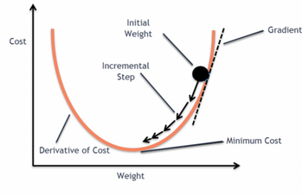
Gradient descent: find the weights minimizing cost

Slide 9
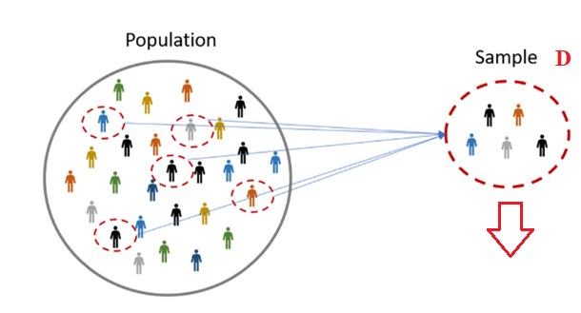
Model performance: finite samples
Most datasets are samples taken from an infinite population.
We are interested in modelling the whole population, we just have access to a finite sample.
Source: Hotcubator

Slide 10
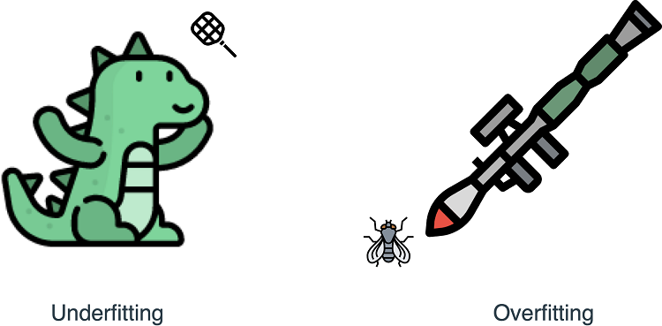
Underfitting and overfitting
Simple models might not be able to fit the training data (underfit)
Complex models fit the training data very well (overfit), but fail to generalize to new examples
Image Credits: https://livebook.manning.com/

Slide 11
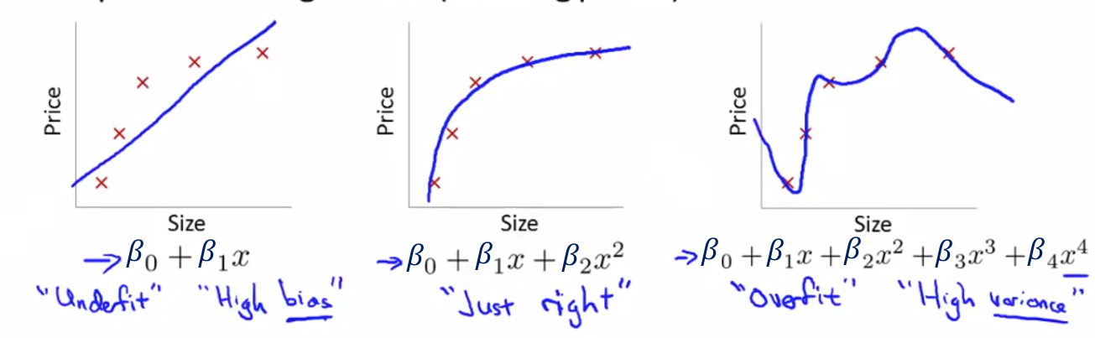
Underfitting and overfitting
Simple models might not be able to fit the training data (underfit)
Complex models fit the training data very well (overfit), but fail to generalize to new examples
Source: Coursera

Slide 12
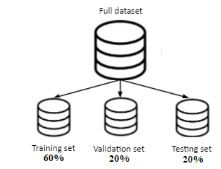
Model selection: Train/Validation/Test sets
Fit model parameters on training set
Choose model/hyperparameter configuration with lower validation error
Evaluate model performance with testing set

Slide 13
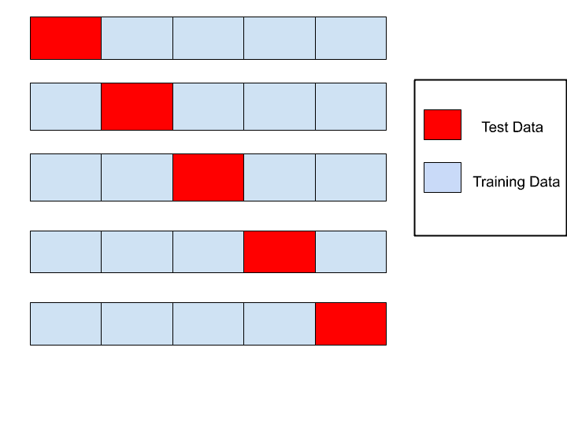
Model evaluation: k-fold cross-validation
More efficient way to compute validation error if we have little data
Average error over the k red portions Validation error
Fold 1
Fold 2
Fold 3
Fold 4
Fold 5
K=5
Source: MLTut

Slide 14
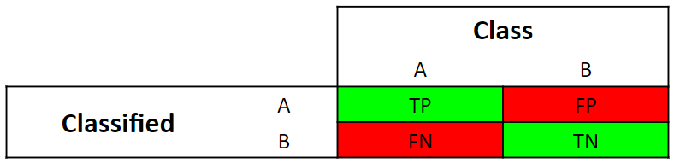

Performance metrics for classification
In binary classification (Yes/no, 0/1), we use the confusion matrix which has 4 values:
True positives: positive examples classified as positive
True negatives: negative examples classified as negative
False positives: negative examples classified as positive
False negatives: positive examples classified as negative

Slide 15
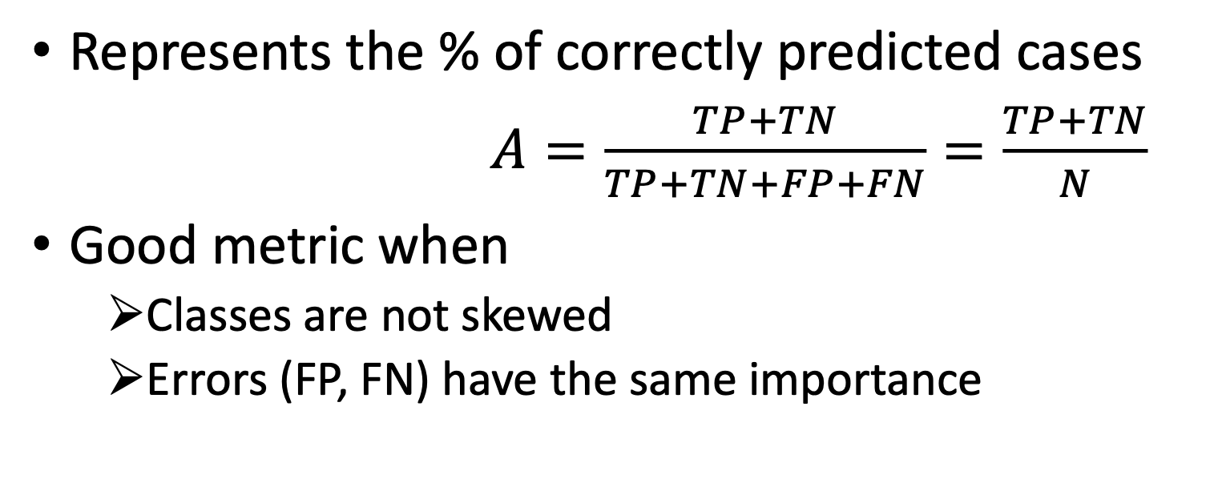

Accuracy: overview
Source: Avinash Pandey

Slide 16
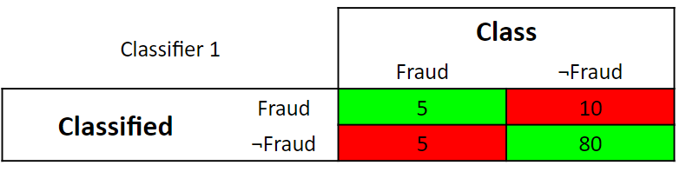
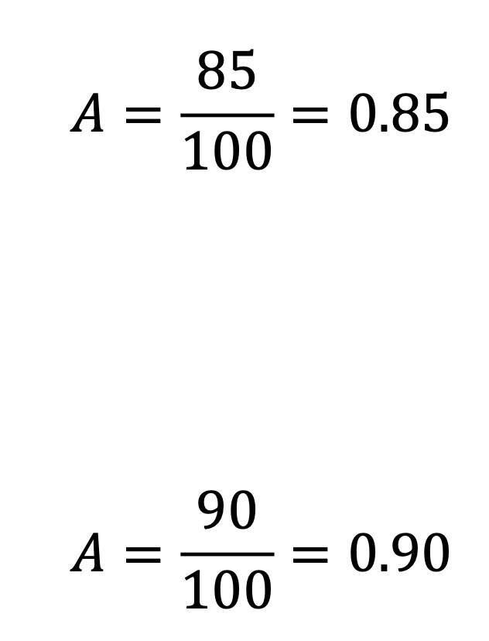



Accuracy: skewed example

Slide 17
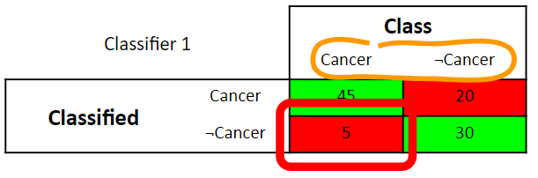
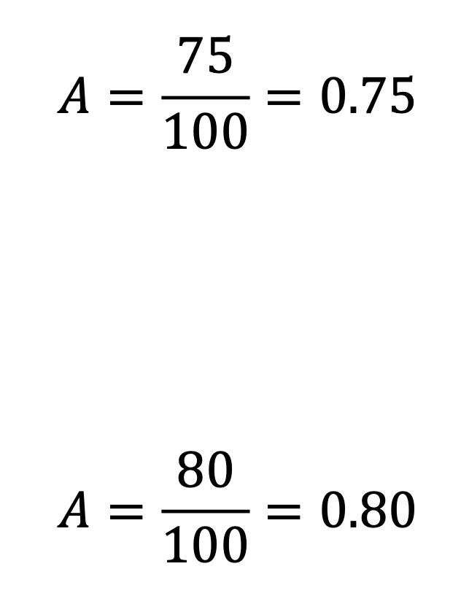

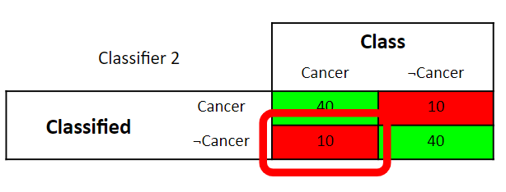

Accuracy: errors with different importance

Slide 18
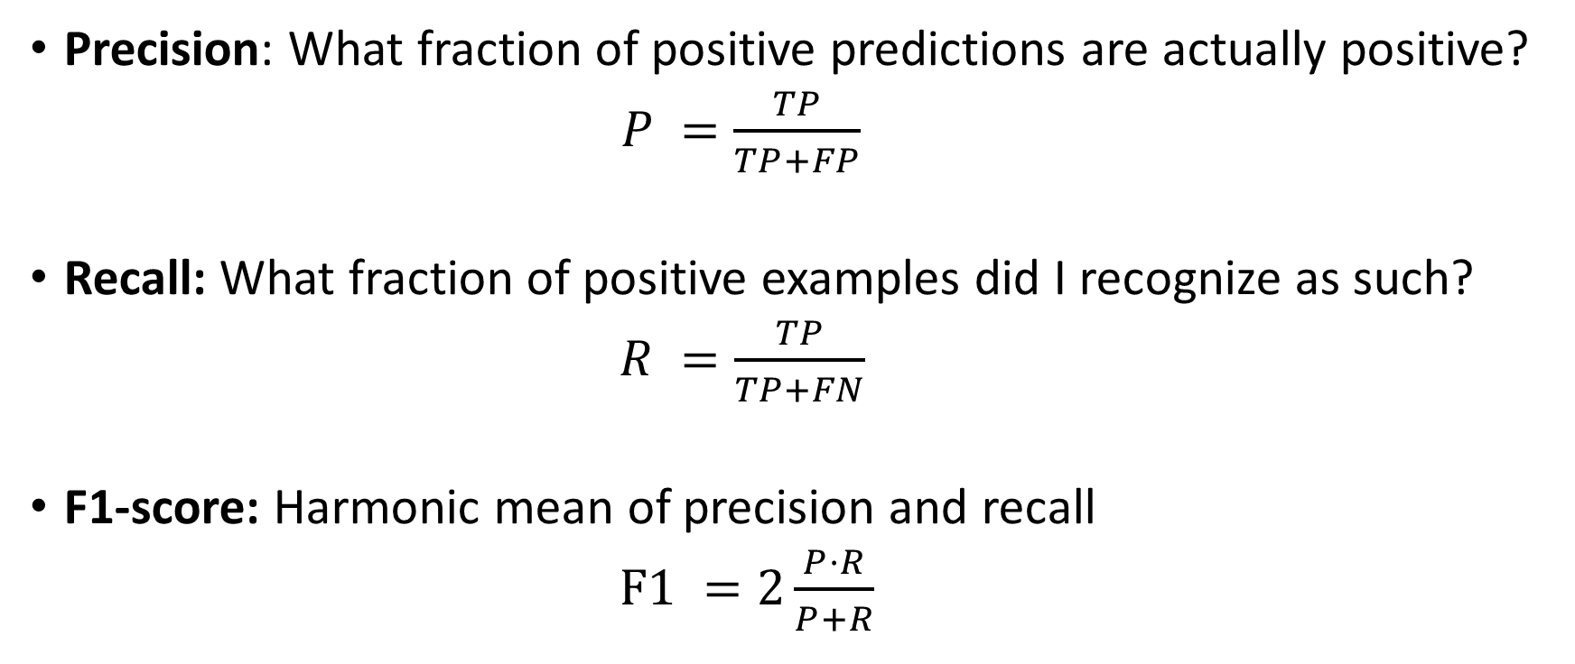
Precision, recall, F1-score

Slide 19
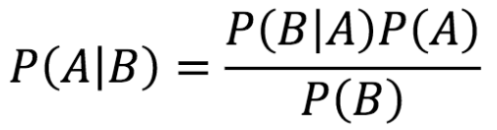
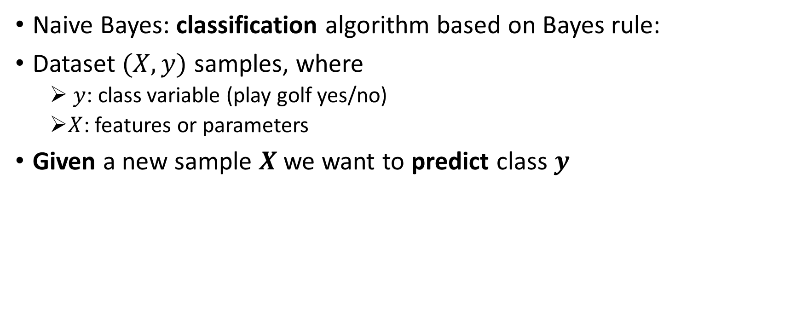
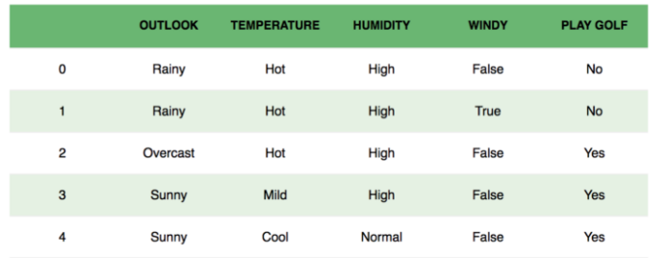
Naive Bayes

Slide 20
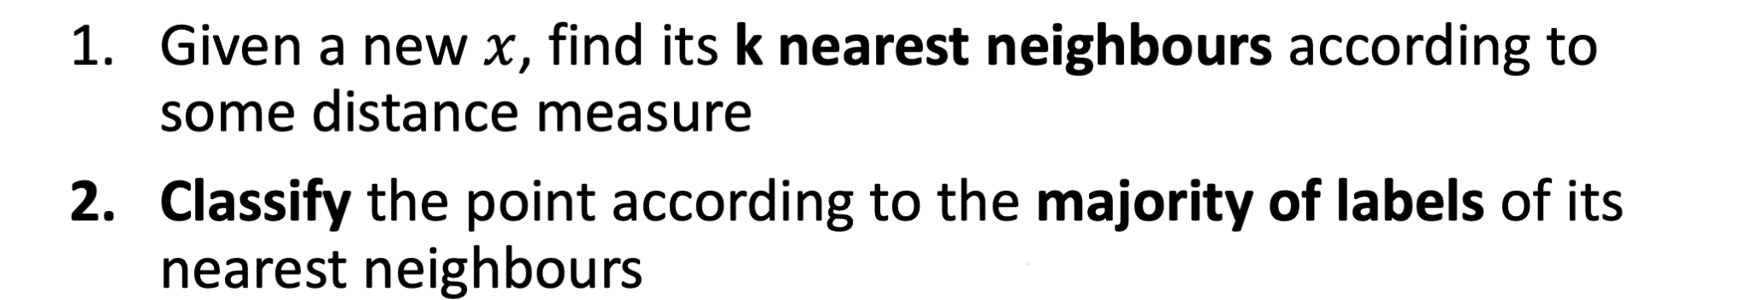
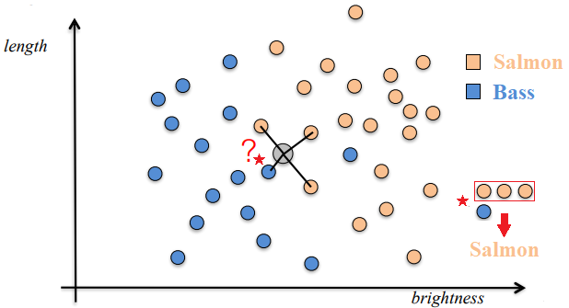
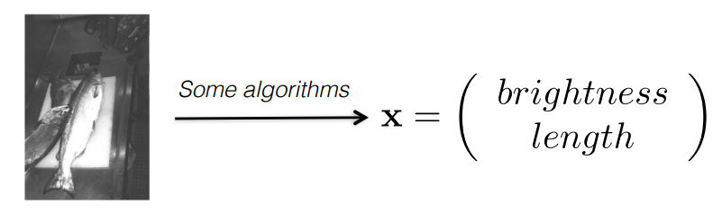
K-nearest neighbours
K = 4
Is it a bass or a salmon?
Credit: Bob West, EPFL

Slide 21
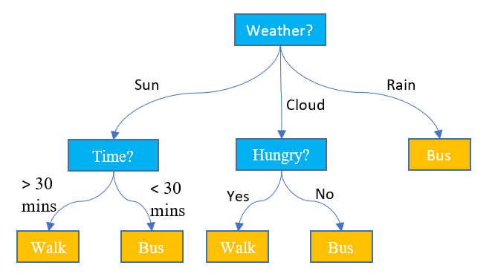
Decision trees
Supervised algorithm that can be used for classification or regression tasks.
The model follows a flow-chart tree structure
Nodes are tests on a single attribute
Branches are attribute values
Leaves are class labels (classification) or output values (regression)
Source: SQLshack

Slide 22

WE WANT TO HEAR FROM YOU
Send us your feedback through this form

